Slide 1
MGMT 6057 contemporary business management
Module 5: entrepreneurship

Slide 2
Agenda
Entrepreneurs vs. small business owners
Advantages and disadvantages of starting a small business
Importance of small businesses
Starting a business
Franchising
Financing
Protecting your ideas (intellectual property)
Business failure
Growing your business

Slide 3
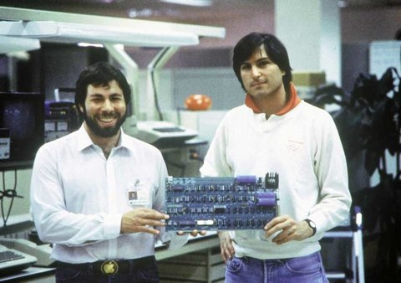
Entrepreneurs and small business owners
Entrepreneurs….
Operate growth-oriented businesses
Take more (calculated) risks
Are relatively more innovative
…compare to small business owners (“lifestyle businesses”)
Take an Entrepreneurship -Self-Assessment Quiz!
Notes:
Steve Wozniak (left) and Steve Jobs, co-founders of Apple Computer, holding an Apple I circuit board, c. 1976

Slide 4

Small business ownership: advantages and disadvantages
Advantages
Own boss
Accommodate lifestyle
Financial reward
Utilize your skills/knowledge, learn new skills
Disadvantages
Time commitment
Responsibility and stress
Financial risk
No security
Need to do things not good at or don’t enjoy
Notes:
Image: https://tse2.mm.bing.net/th?id=OIP.BUMCNti4MV9pyNHvBRVVHwAAAA&pid=15.1&P=0&w=226&h=160

Slide 5
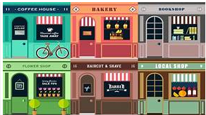
Importance of small businesses
Jobs
Entry point for most workers
Small firms hire and fire workers more frequently than larger firms
Innovation
More patents per employee than large firms
Complement larger organizations at different points in their supply chains
Notes:
Image: https://tse2.mm.bing.net/th?id=OIP.5LITftJ6YuPuPgHyiggZhwHaEK&pid=15.1&P=0&w=287&h=162

Slide 6
Starting a Business
What is the business idea?
Is it feasible?
Does it fill an unmet need or solve a problem?
What is the competitive advantage?
What is the target market and industry?
How will it be started (new, buy existing, franchise)
What form of ownership will it use? (see previous chapter)
How will it be financed?
Create a business plan
20 reasons why you need a business plan
Business plan outline
Etc…. (see info guides for starting a small business, such as Royal Bank of Canada guide)

Slide 7


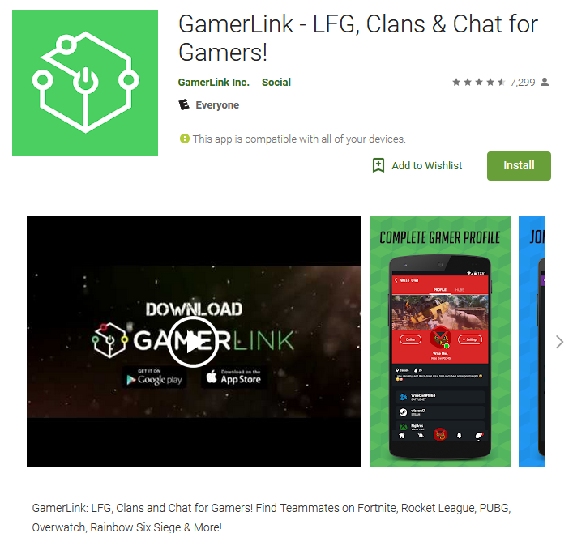
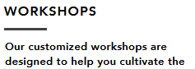

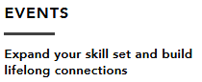
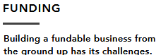
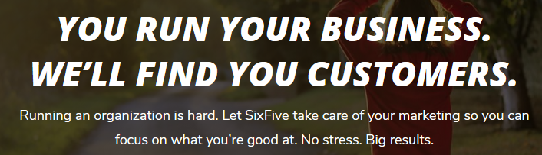
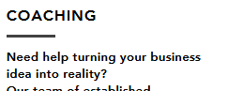
Fanshawe college entrepreneurial services: LeaP junction
www.leapjunction.ca
60-second pitch competition
Video: LEAP Junction

Slide 8

Starting a Business (cont’d)
Start from scratch (new)
Most common
Highest risk
Most flexibility to build the business any way you want
Buy an existing business
Proven product, current customers, active suppliers, trained employees, a known location
Due diligence is required!
Notes:
Image: https://tse1.mm.bing.net/th?id=OIP.dnjQtQuLN2hkNrJ0-R__BwHaIa&pid=15.1&P=0&w=300&h=300

Slide 9





Starting a business (cont’d)
Franchise: a licence to use someone else’s trademark, products, and business practices for a period of time
Franchiser: The business selling the franchise licence
Franchisee: The individual/business buying the franchise licence
Buying a Franchise in Canada
Notes:
https://www.betheboss.ca/top-100-franchises (list of top five franchises in Canada (by number of units)

Slide 10
Starting a business - Franchise (cont’d)
Advantages
Existing brand reputation
National & regional sales promotions
Proven business practices – secret recipes, procedures, bookkeeping
Suppliers & volume discounts
Training
Exclusive area
Financial assistance
Turn-key operation
Disadvantages
Franchise fee
Royalty fees based on sales volume
Follow rules of franchise:
Deal with franchise suppliers
Sell only franchise products
Follow franchise sales promotions

Slide 11

financing
Early stage
Personal funds
Savings
Friends and family
Personal credit cards (BAD IDEA)
Crowd funding (e.g. Kickstarter)
Angel investors ($)
Later stage
Venture capitalists ($$$)
Notes:
Image: https://tse4.mm.bing.net/th?id=OIP.fj_sTr54OjRLDT46blgZMwHaE8&pid=15.1&P=0&w=269&h=180

Slide 12


Protecting your ideas: Patents, trademarks, copyrights
Patent: inventor has right to make, use, sell the invention for a set period of time (20 years)
Copyright: protects literary works, music, art, software, maps, photographs, sculptures, databases, performances, etc.
If you were hired or employed to create it, your employer owns the copyright (not you)
No one can publish, perform, translate, or adapt the creation without permission
Typical copyrights last for the life of the author (or date of publication, performance, etc.) plus 50 years

Slide 13

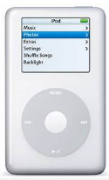
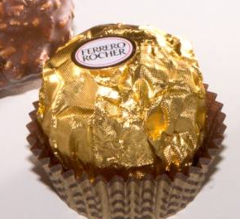
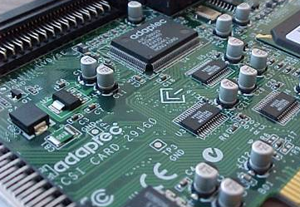
Protecting your ideas: Patents, trademarks, copyrights
Trademarks: Words, symbols, designs (or a combination) that identify a product or service & distinguish it from competitors. A trademark is is valid for 15 years &is renewable. Includes:
Ordinary Marks: words/symbols that distinguish the goods or services of a specific firm
Certification Marks: identify goods/services that meet a defined standard
Distinguishing Guises: unique shape of a product or package
Industrial Designs: anything made by hand, tool or machine that has distinctive features (e.g., the shape of a chair)
Integrated Circuit Topographies: Configurations of electronic circuits

Slide 14
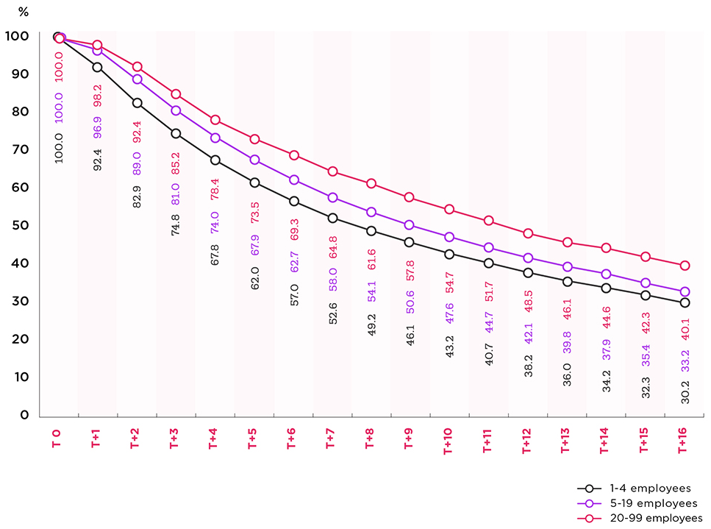
Business survival rates (december 2019)
Notes:
Source: http://www.ic.gc.ca/eic/site/061.nsf/eng/h_03126.html#1.3

Slide 15

Why Businesses Fail
Poor idea
Cash flow (or poor cost control)
Lack of skills, experience
Lack of customer focus
Unable to handle growth
Others reasons: human resource problems, owner ‘burnout’, failing to execute business plan, external shocks (e.g., new competition, economic downturn, other PESTLE changes)
Notes:
Image: https://tse3.mm.bing.net/th?id=OIP.KzqjDeGursFPgCbitoviCwHaF4&pid=15.1&P=0&w=252&h=201

Slide 16

Warning signs of impending business failure
Negative change in accounting reports
Business plan objectives not being met
“Writing off” bad debts (being unable to collect on accounts receivables)
Inability to meet payments on debt (loans)
Cost overruns (consistent budget deficits)
Loss of clients
Loss of key employees
Drastic changes in external environment
Notes:
Image: https://tse3.mm.bing.net/th?id=OIP.BSaofme5Hq0opSvnkvqY4gHaD4&pid=15.1&P=0&w=364&h=191

Slide 17

Growing your business
Multiple locations
New client bases (e.g., B2B, B2C, government, e-commerce)
New products
Licensing (other businesses use your intellectual property for a fee)
Franchising (become a franchiser)
Mergers and acquisitions (“2 becomes 1”)
Strategic alliances (“2 becomes 3”)
Notes:
http://entrepreneurs.about.com/od/businessplan/a/growthstrategy.htm (Outlining a Growth Strategy: How do you plan to grow your business beyond the initial launch?
From Scott Allen, About.com Guide) – excerpts (although I added licensing, m & a’s, alliances)
Licensing: https://www.entrepreneur.com/encyclopedia/licensing
Image: https://ca.images.search.yahoo.com/images/view;_ylt=AwrJ6iSaiuNc92IA6w8.7olQ;_ylu=X3oDMTIyZXRrb3FwBHNlYwNzcgRzbGsDaW1nBG9pZANlMDQ0MDk0MDA1MmQ0MTYxNjczNDBmMGU3ZTg3ZTNjMARncG9zAzcEaXQDYmluZw--?back=https%3A%2F%2Fca.images.search.yahoo.com%2Fyhs%2Fsearch%3Fp%3Dbusiness%2Bgrowth%26n%3D60%26ei%3DUTF-8%26fr%3Dyhs-rogers-rogers_001%26fr2%3Dsb-top-ca.images.search%26hsimp%3Dyhs-rogers_001%26hspart%3Drogers%26tab%3Dorganic%26ri%3D7&w=1024&h=741&imgurl=www.customonit.com%2Fblog%2Fwp-content%2Fuploads%2F2015%2F01%2Fbusiness-growth-1024x741.png&rurl=https%3A%2F%2Fwww.customonit.com%2Fblog%2Fthinking-of-expanding-ask-yourself-these-4-questions-first%2F&size=500.4KB&name=Thinking+of+Expanding%3F+Ask+Yourself+These+4+Questions+...&p=business+growth&oid=e0440940052d416167340f0e7e87e3c0&fr2=sb-top-ca.images.search&fr=yhs-rogers-rogers_001&tt=Thinking+of+Expanding%3F+Ask+Yourself+These+4+Questions+...&b=0&ni=112&no=7&ts=&tab=organic&sigr=12r75na8c&sigb=15m5qk368&sigi=12f1b0i9h&sigt=11pjlq78v&sign=11pjlq78v&.crumb=.e20qG3X3C8&fr=yhs-rogers-rogers_001&fr2=sb-top-ca.images.search&hsimp=yhs-rogers_001&hspart=rogers

Slide 18



Mergers, acquisitions, strategic alliances
Merger: two companies combine together (e.g., Fiat Chrysler)
Acquisition: one company purchases another company (e.g., Kraft acquired Cadbury)
Alliance: two companies contribute resources to start a (usually non-permanent) initiative or venture (e.g., Sony and Microsoft cloud gaming alliance)
Why? Access to markets/ distribution channels/ products/ technology, synergies, etc.
Notes:
Image Source: https://tse4.mm.bing.net/th?id=OIP.eWKJz6YpByBg_OFipV3boQHaF5&pid=15.1&P=0&w=196&h=157

